Slide 1
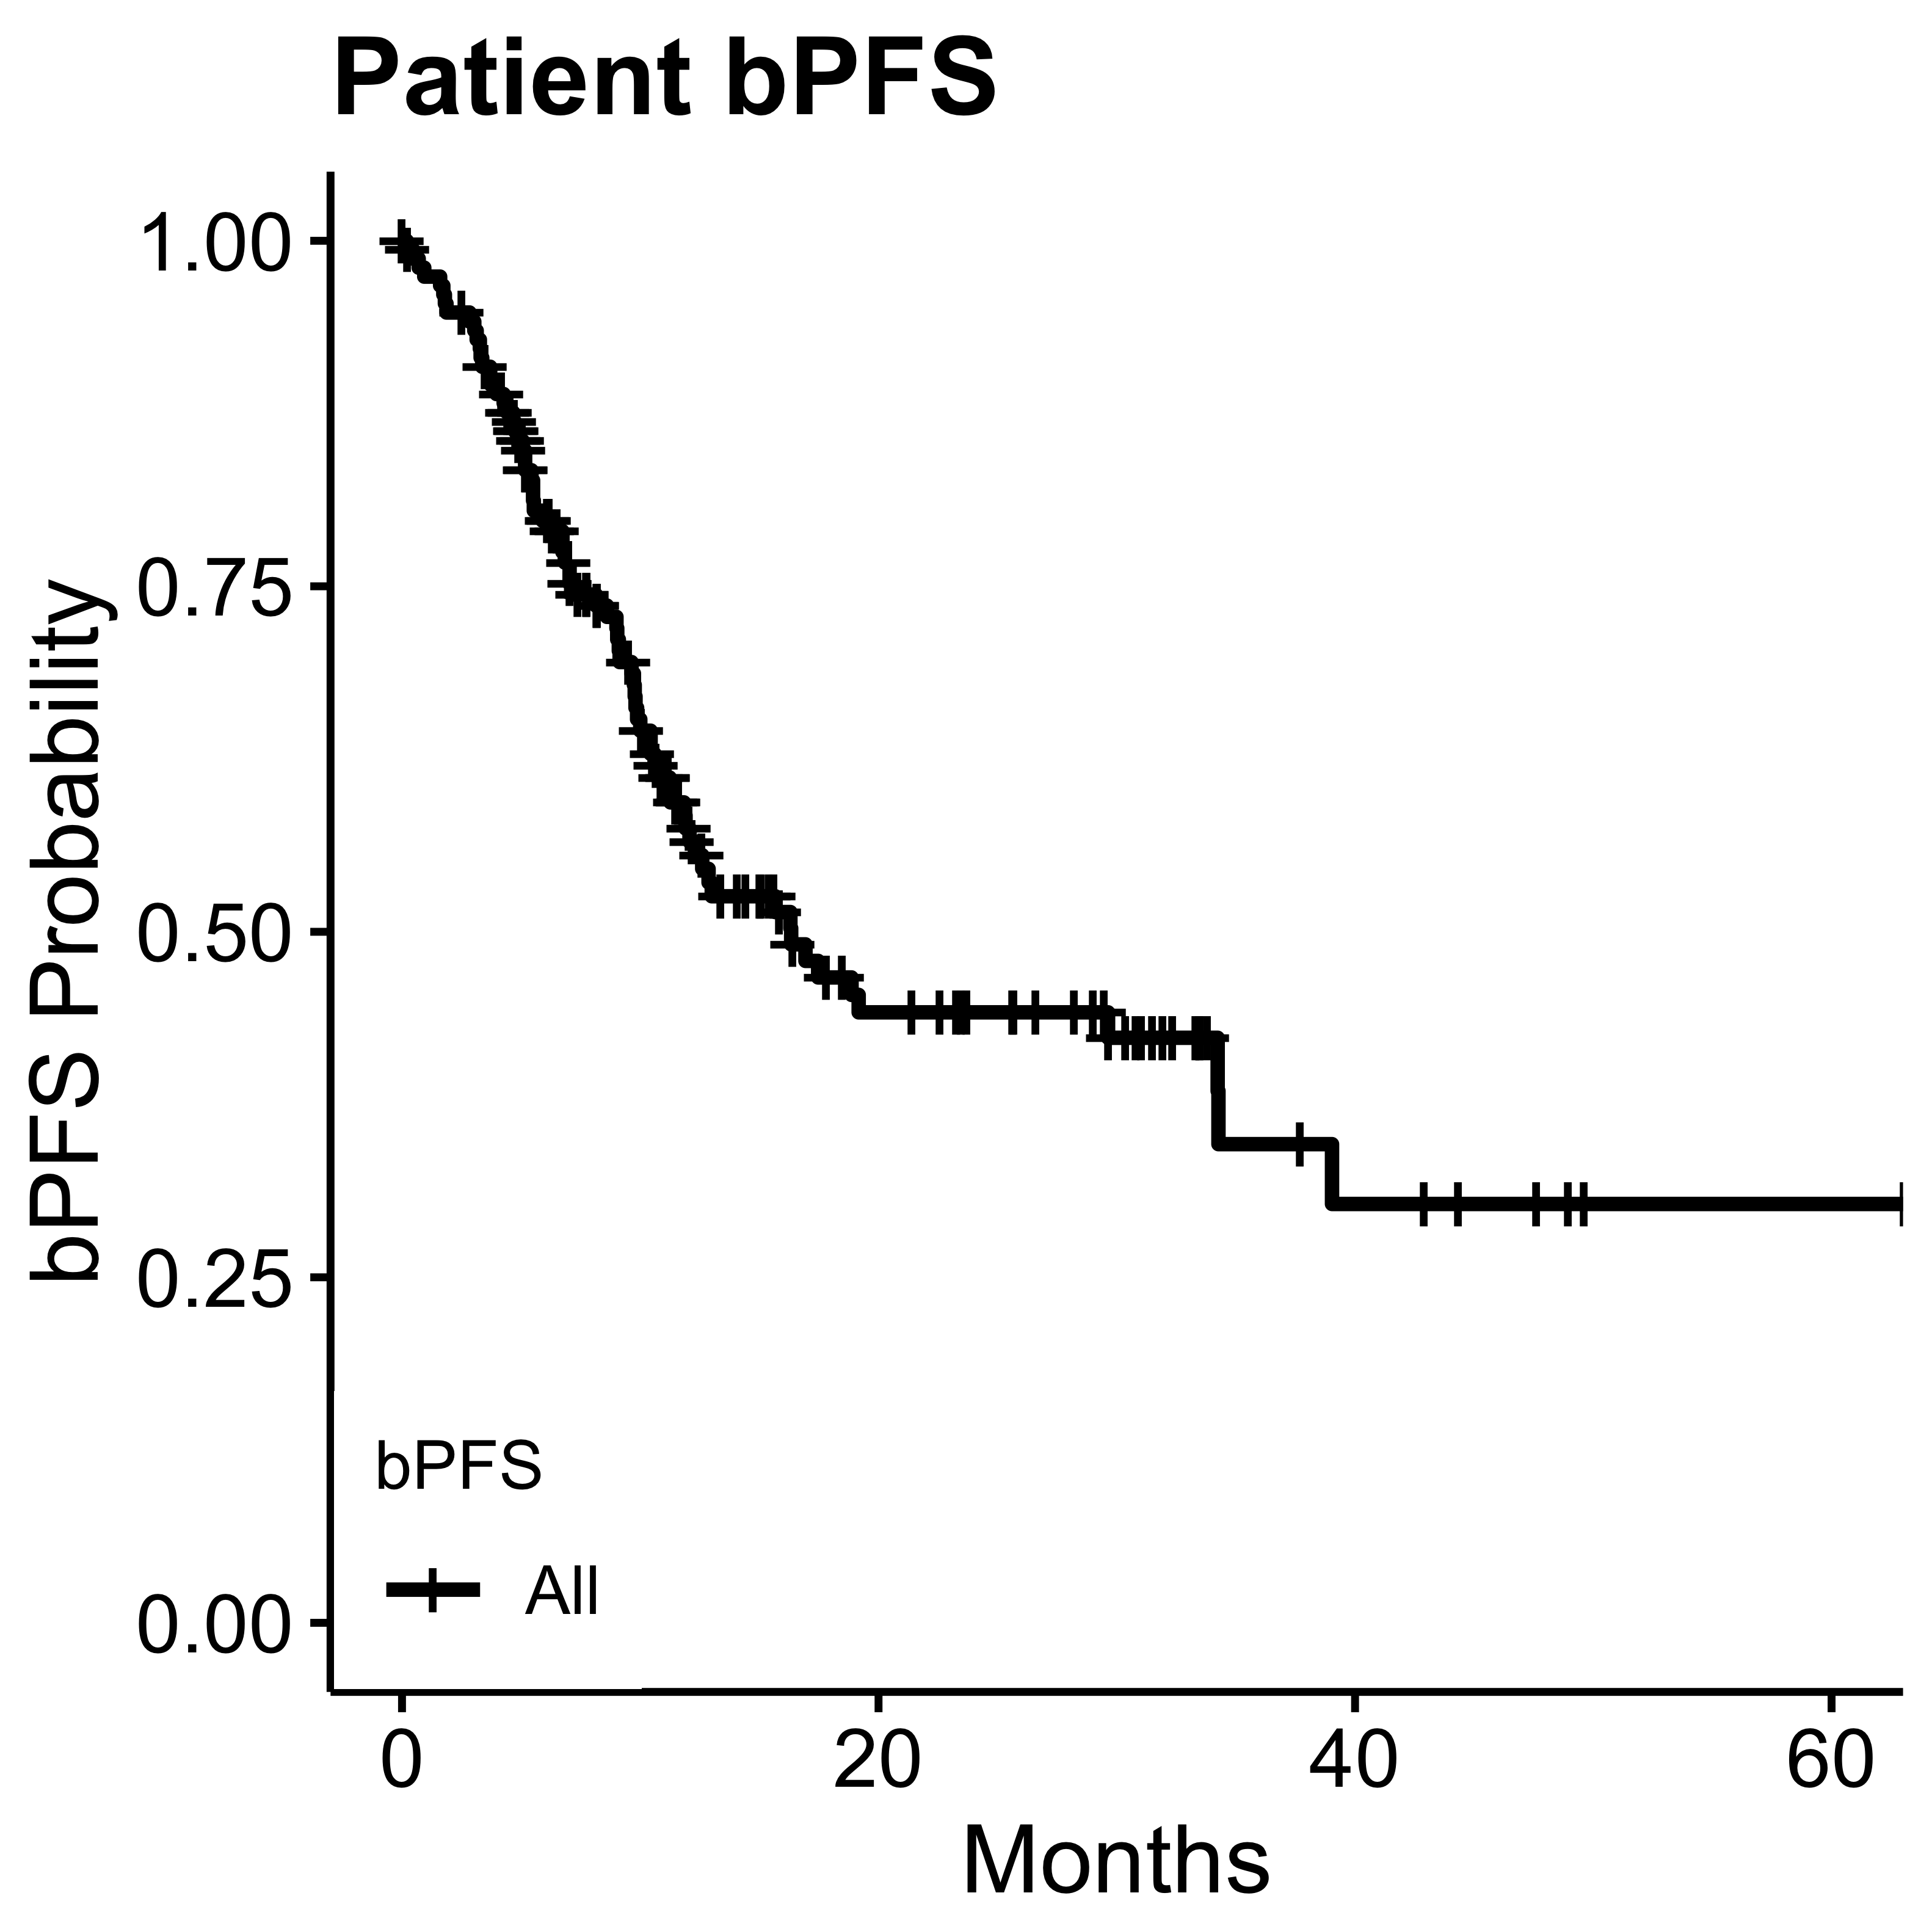
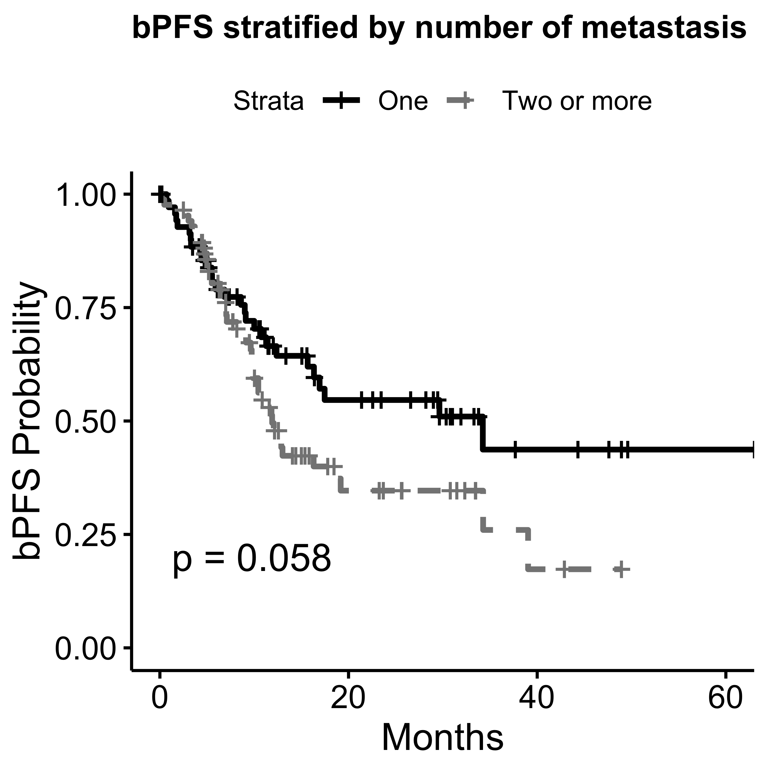
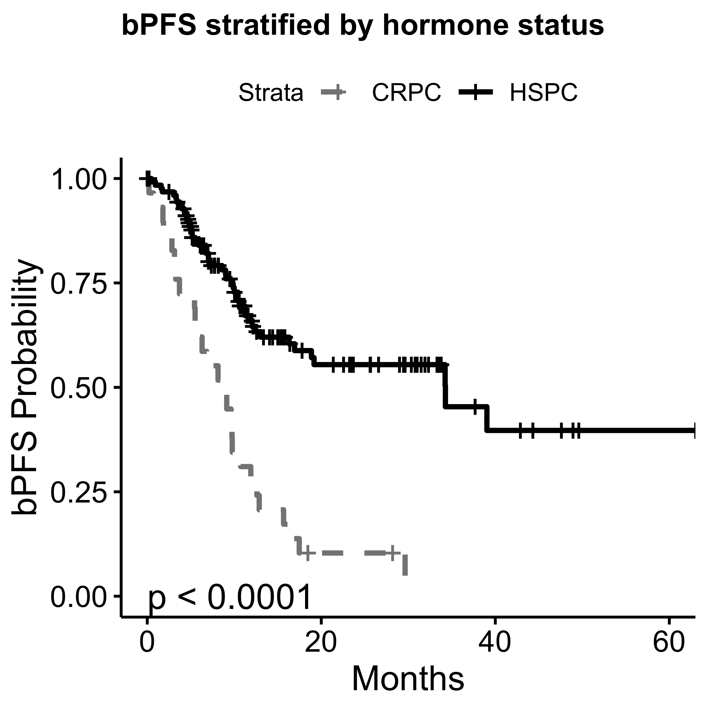
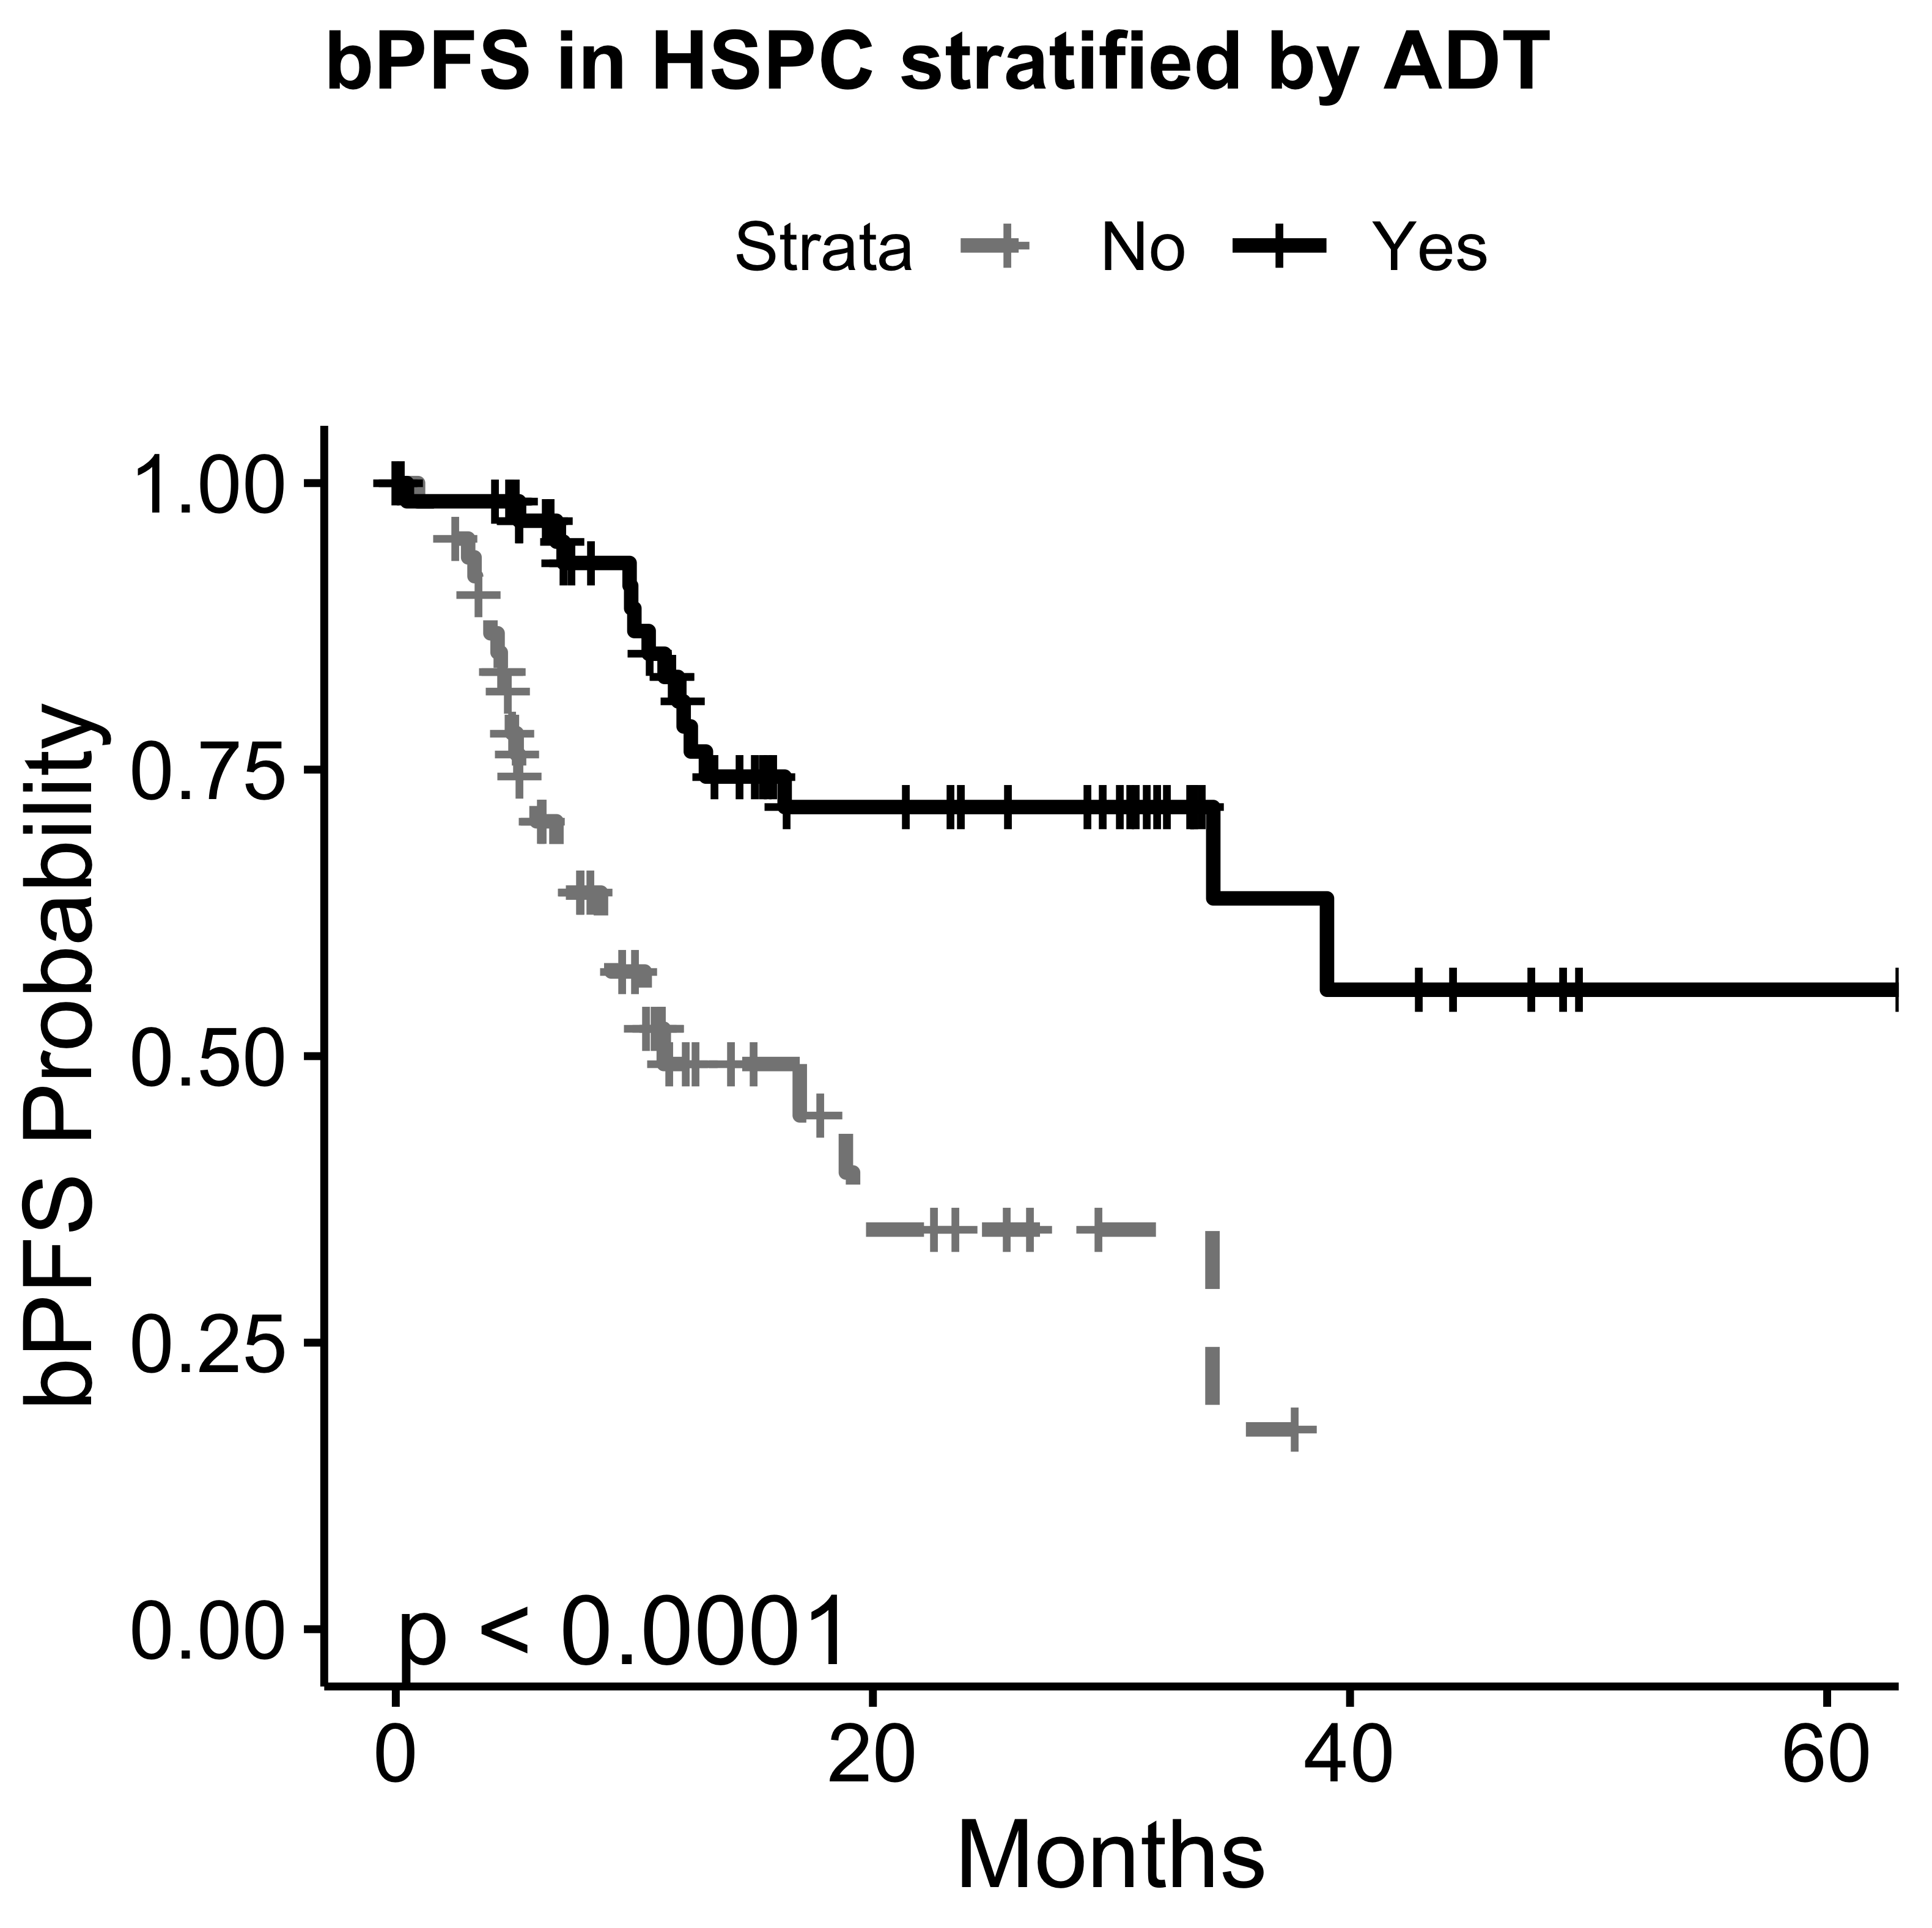
Radiotherapy In The Definitive Management Of Oligometastatic Prostate Cancer: The Johns Hopkins Experience
The role of local therapy in the management of oligometastatic disease is a rapidly evolving paradigm. Evidence suggests its integration as consolidation therapy in de novo or oligorecurrent disease is associated with improvements in overall survival. Within prostate cancer (Pca) specific cohorts SABR appears safe and effective in forestalling the initiation of androgen deprivation therapy in oligorecurrent hormone-sensitive disease. However metastatic PCa represents a heterogeneous disease and little data for the use of SABR exists across the various subgroups. Therefore here we report outcomes across these diverse patient populations and attempt to identify factors associated with improved oncologic outcomes.
This study analyzed 156 oligometastatic PCa (OPCa) patients and 354 metastatic lesions. Median biochemical progression free survival (bPFS) for the entire cohort was 12.9 months and 52% at one year. On multivariable analysis, factors associated with prolonged bPFS were peri-RT androgen deprivation (ADT), lower GTV, and hormone sensitive (HS) OPCa. A group of 28 men with hormone sensitive OPCa treated with a course of peri-RT androgen deprivation (median 4.3 months) with recovery of testosterone. At median 33.5 month follow up, 20 have not developed bPFS, median bPFS has not yet been reached, and 24 month bPFS was 77%.

